Slide 1


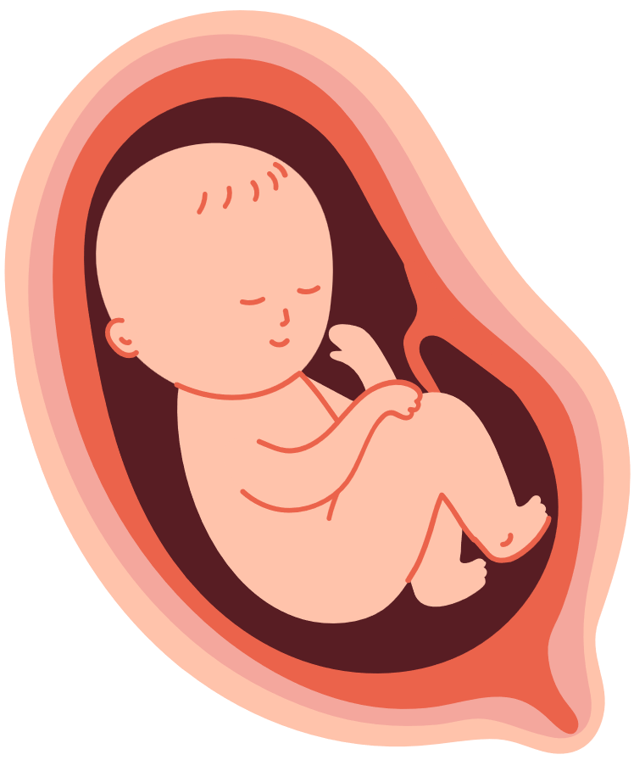
WONDERFULLY
MADE
A look into the stages of a baby’s life in the womb.
Notes:
[Have students line up fruits/vegetables from smallest to largest.]
We are going to discover how babies grow from small to large before they are born.
We are all wonderfully made by God. Let's look at His handiwork!

Slide 2


18 DAYS
Baby’s heart is beating
Notes:
What did God create that has a heartbeat? (people, animals) What does a heartbeat say about something? (It is alive.)
[Drum a "normal" adult heartbeat--between 60 and 100 beats per minute.]
By the time a baby is 18 days old, his or her heart has started beating, and it will continue to beat for life. Baby is producing and pumping his or her own blood, and through baby’s placenta which attaches to mom inside her womb, baby will receive nutrients and use them to grow.
This is how fast a baby’s heart beats!
[Drum the fast patter of an 18-day baby’s heartbeat--165 to 170 beats per minute.]

Slide 3
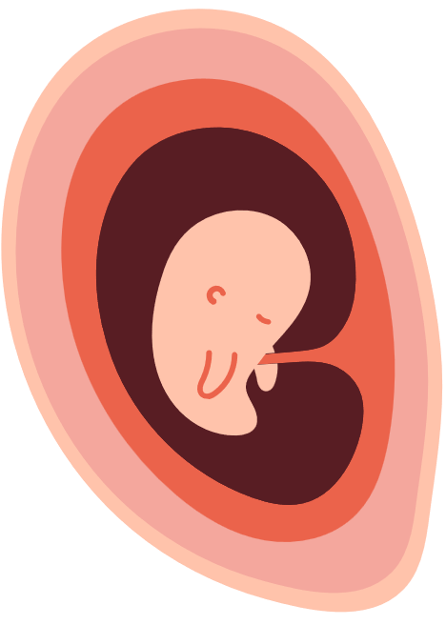
7 WEEKS
1/2" long
Eyes have some color.
Brain is growing.
Hands and feet are developing.
Appendix, pancreas, intestines are growing.
Blood vessels carry oxygen and nutrients.
Baby can hiccup.
Baby starts to move and exercise muscles.
Notes:
[Show a blueberry.]
Can you believe since you were this little, you could jump and leap? Here are some other ways your body was growing and changing. (Read facts above.)

Slide 4
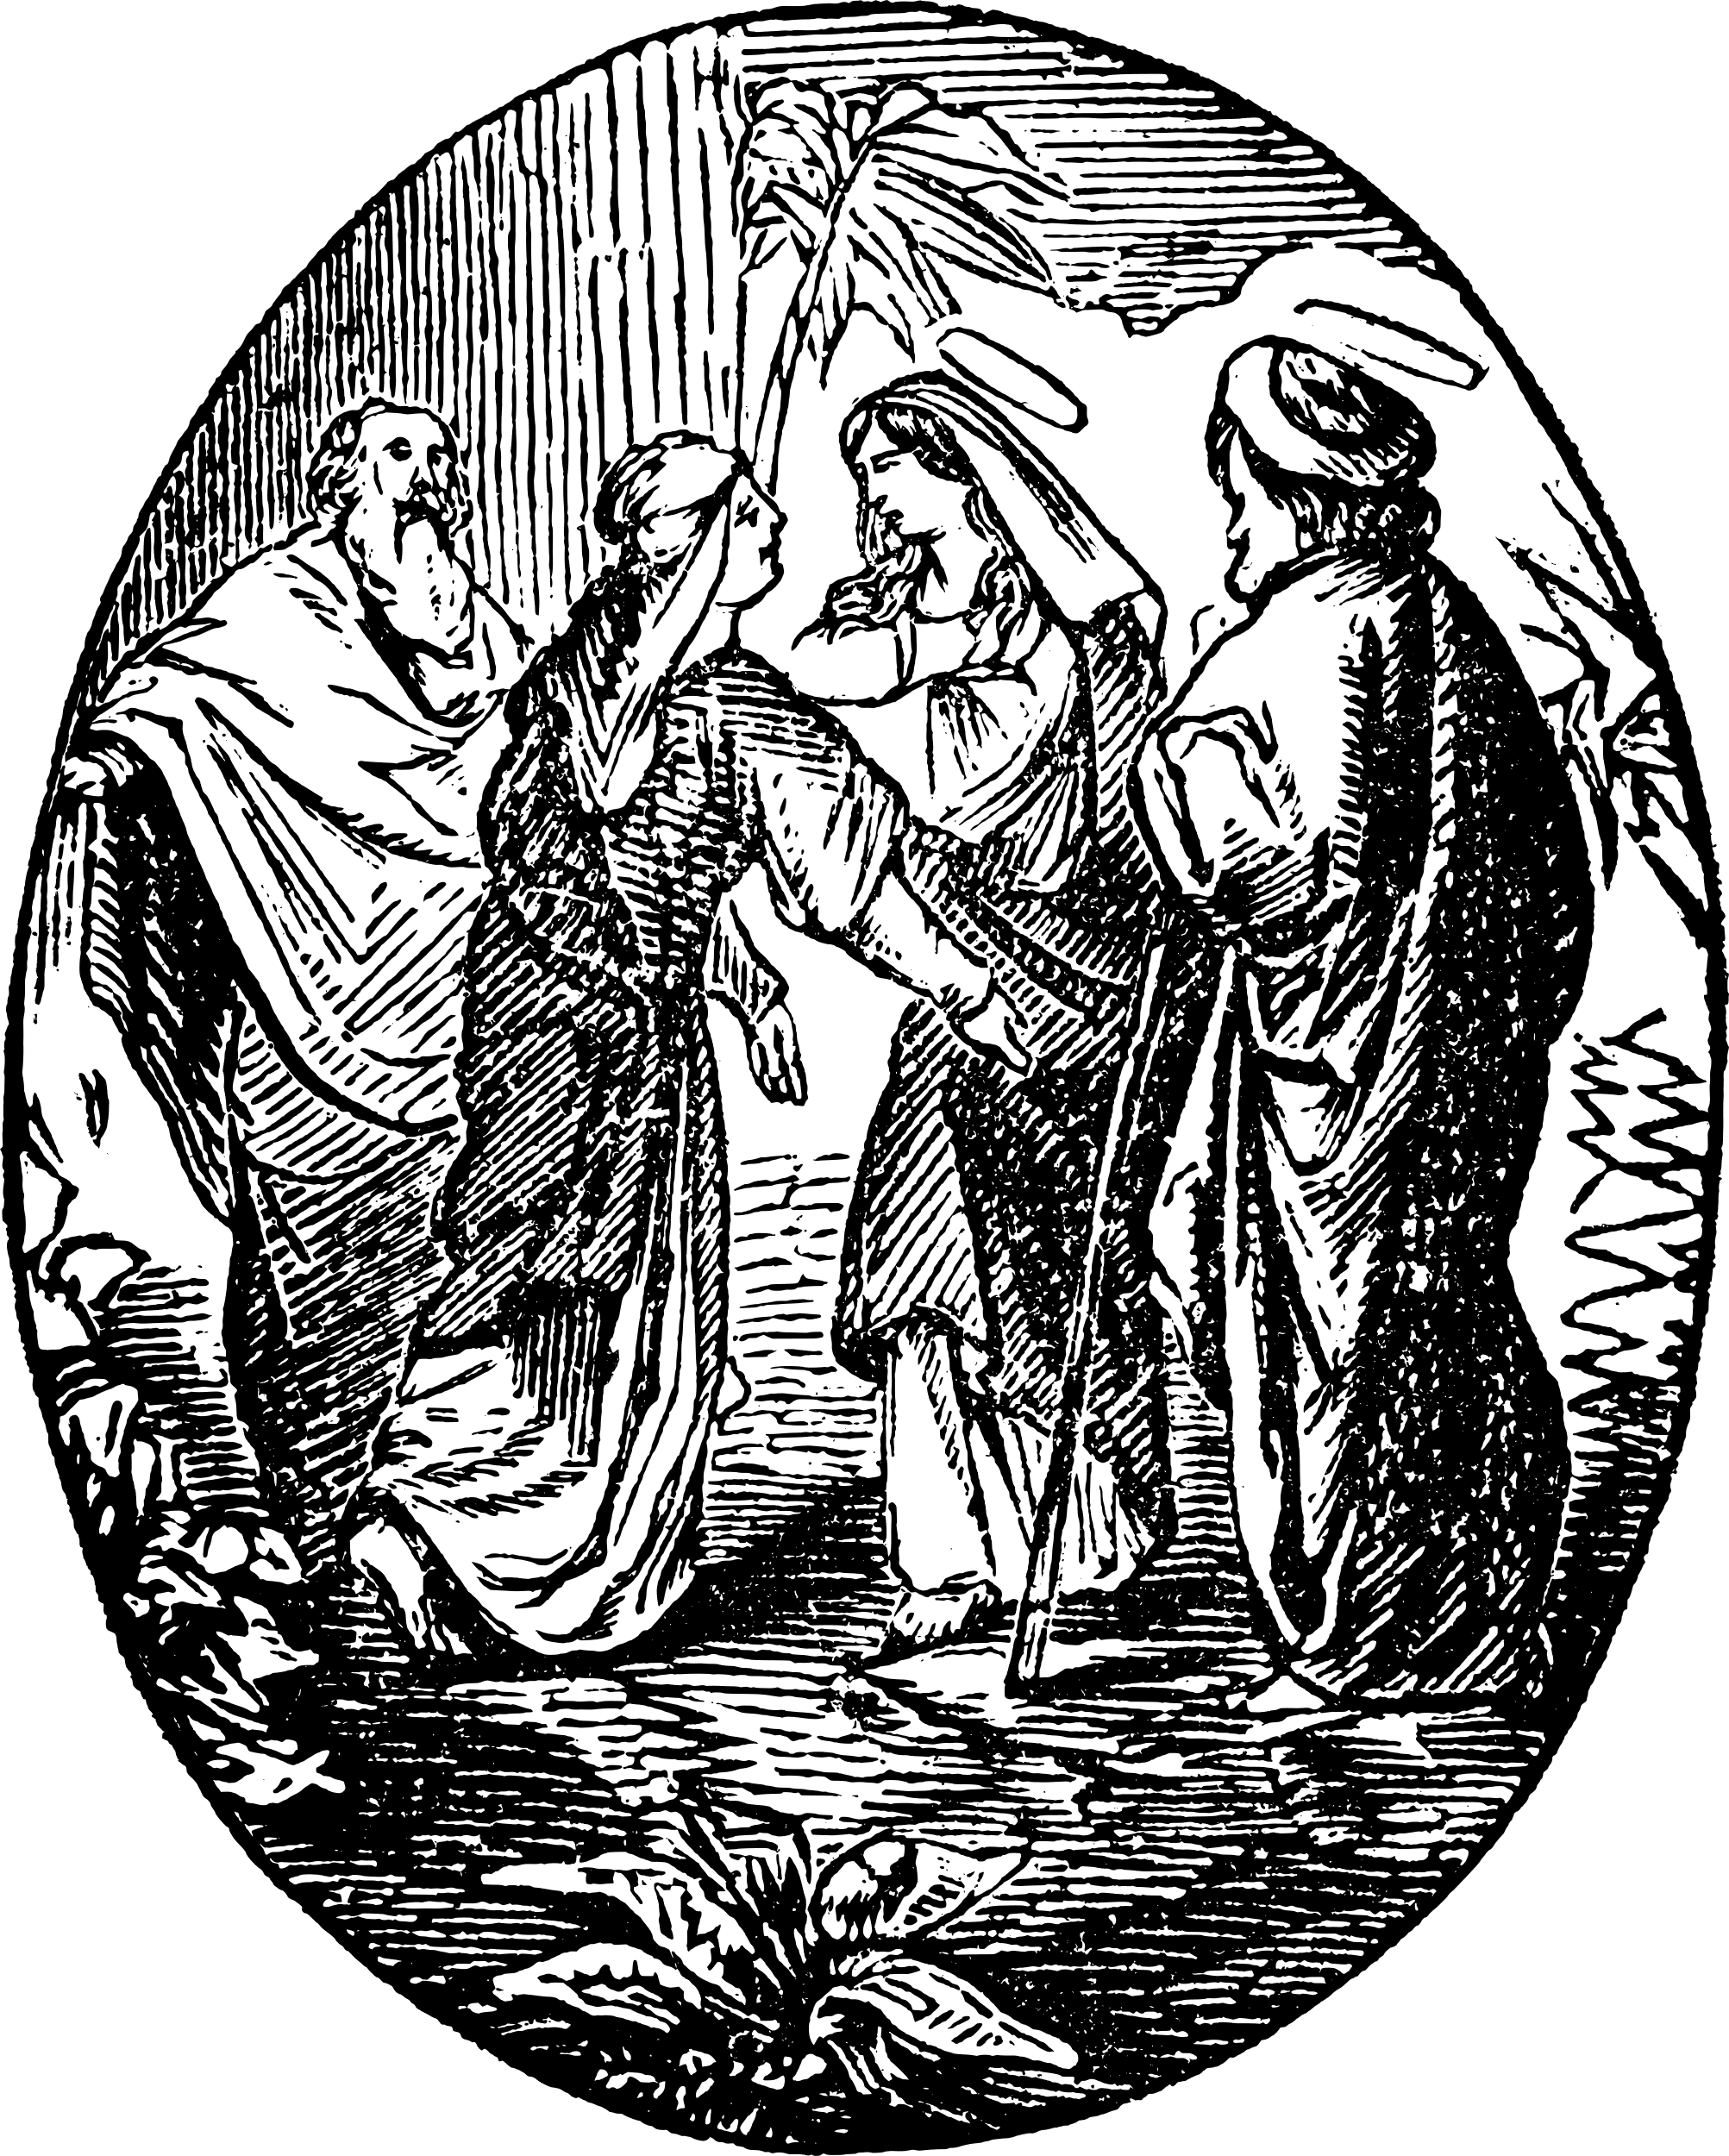
Baby John & Baby Jesus
Elizabeth’s unborn baby was aware of baby Jesus that Mary was carrying.
Luke 1:44- “As soon as the sound of your greeting reached my ears, the baby in my womb leaped for joy.”
Baby John already knew Jesus as his Savior at this age. God can grant faith even before a baby is born.
Notes:
Why did John leap in his mother's womb? (Because he recognized Jesus!) Did John have faith? (Yes.) Who gives us faith? (The Holy Spirit.) Can babies have faith? (Yes.)

Slide 5
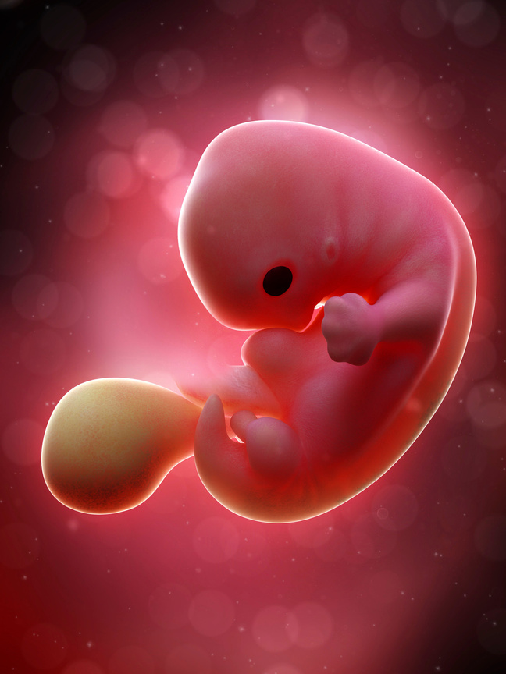
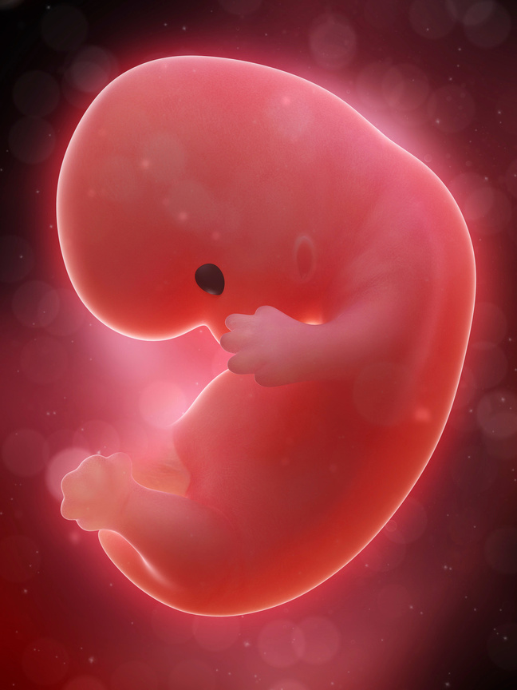
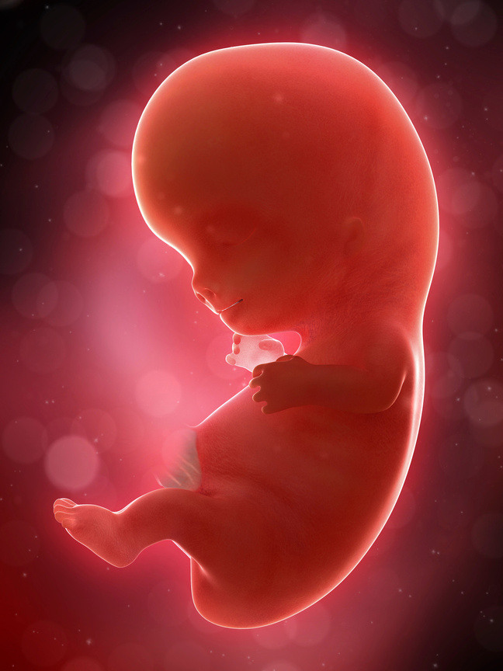
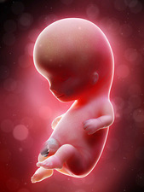
7, 8, 9, and 10 weeks
Notes:
Here you can see how a baby grows during weeks seven, eight, nine, and ten. He or she almost triples in size!

Slide 6
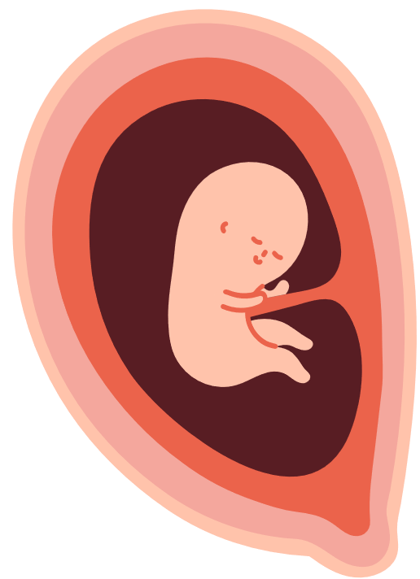
12 WEEKS
Size of a lime
Fingers can open and close.
Toes can curl.
Baby can swallow.
Baby feels and responds to touch and pain.
Baby can smile.
Baby can suck his or her thumb.
Notes:
[Pass around 12-week model.]
[Show lime.]
[Have kids open and close fingers as babies are beginning this movement. See if they can curl their toes as well.]

Slide 7

Psalm 139:13- “For you created my inmost being; you knit me together in my mother’s womb.”
All the parts of a baby are made with purpose by God. None of it is an accident.
Notes:
[Read verse together.]
This applies to each of us. It is God's work to create each baby from the beginning.

Slide 8
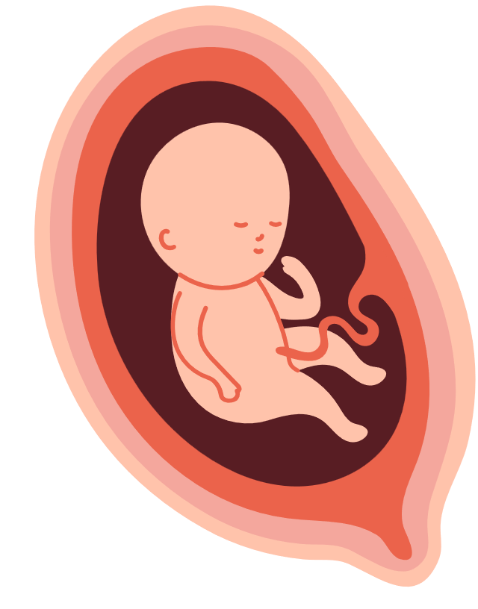
22 WEEKS
Size of a banana
Practices swallowing
Can make facial expressions
Over half-way through pregnancy
Taste buds are working.
Eyebrows and eyelashes are growing.
Can open and close eyes.
Notes:
At 16 weeks, a mom can feel the baby moving. (Pass around the 16-week baby.) Baby is four times bigger than he was one month ago. Do you grow four times bigger in just one month? If you did, you would be a giant!
Now at 22 weeks... [Pass around the 22-week model and do together some of the things the baby can do.]
Did you know you started learning these things before you were even born?
What foods would you tell the baby are good to taste?

Slide 9
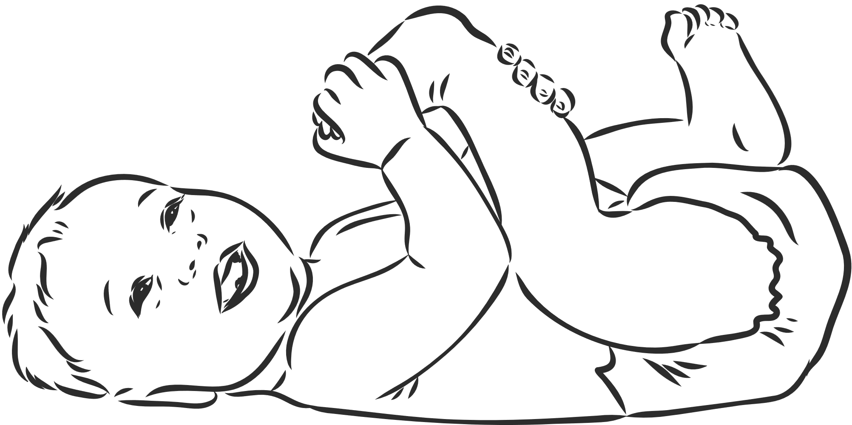
Psalm 139:14- “I praise you because I am fearfully and wonderfully made; your works are wonderful, I know that full well.”
We praise and thank God for making all of us with such care. Since god put so much care, time, and work into creating each baby, we want to take care of them, protect them, and thank God for them.
Notes:
Think of something you have made or have spent a lot of time working on. [Share as time permits.]
How would you feel if someone said it didn't matter or if they didn't like it? What if they did not take care of it? We know babies are special because God made them! We want to protect them and take care of them. We love babies even before they are born because babies are always gifts from God.

Slide 10
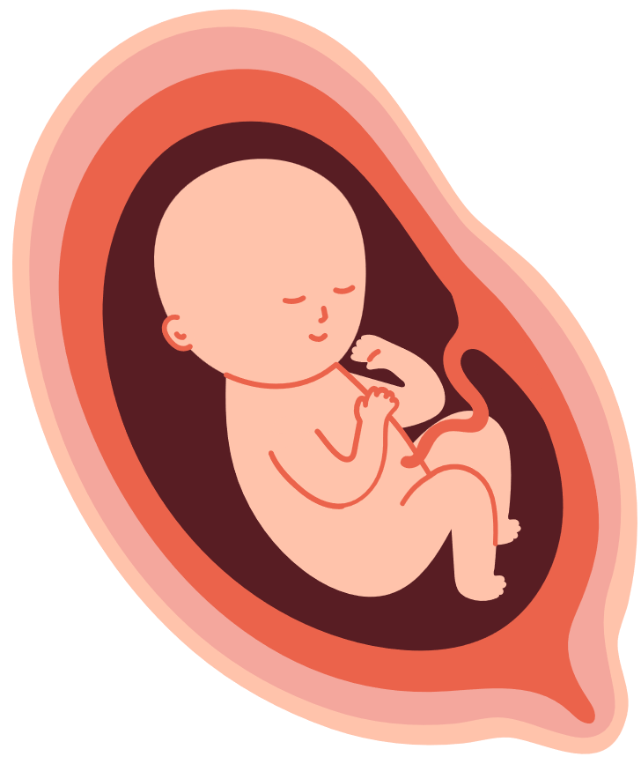
26 WEEKS
Size of a head of cauliflower
Sweat glands are working.
Baby can hear you.
Lungs are developing.
Immune system is developing.
Notes:
[Pass around 26-week model.]
Baby can hear you. You could come up and say hi! What would you say to a baby brother, sister, cousin, or friend?

Slide 11

Psalm 139:14- “My frame was not hidden from you when I was made in the secret place. When I was woven together in the depths of the earth, your eyes saw my unformed body. All the days ordained for me were written in your book before one of them came to be.”
God has each person’s life planned - “written in His Book” - before that life ever began. That is how well He cares and knows each person.
Notes:
When a baby is this old, no one really knows what he or she looks like. No one knows what the baby's eyes look like, what kind of nose he or she has, or what his or her smile looks like. But God knows! It is a secret to us, but God knows exactly who this baby is and what he or she looks like. He knows exactly what he or she will be good at and what he or she will do in his or her life.

Slide 12
30 WEEKS
Size of a large cabbage
Baby is very active.
Others can see movement.
Bones are fully developed.
Baby is gaining fat.
Eyes are open.
Notes:
Baby is able to survive outside the womb but is not at full term. (In fact, baby is able to survive at 21 weeks!) If a baby is born early, we take special care of that baby in the hospital. We thank God for doctors and hospitals that can take care of babies born early. Baby will be full term - ready to be born - at 40 weeks.

Slide 13
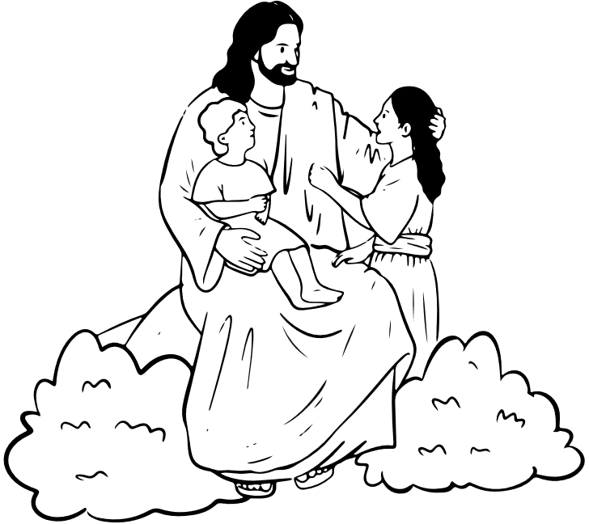
Psalm 49:1- “Listen to me, you islands; hear this, you distant nations: Before I was born the Lord called me; from my birth he has made mention of my name.”
God calls us as His children and knows our name even before we are born!
Notes:
Do you know why your parents named you your name? One way you feel known by someone is if they know your name. God knew your name from the very beginning. He knows you. He knows all people from the very beginning - back before a baby is the size of a blueberry even! That shows us how very important these babies are and how very important you are! God made you and Jesus died for you so you could live forever with Him some day. Jesus loves you very much, and He started loving you from the moment you came to be inside your mother’s womb!

Slide 14


Created by Lutherans For Life and Y4Life
Images sourced from Canva and Science Photo Library
Notes:
Additional time:
1) Ask "At what week does..." review questions.

