Slide 1


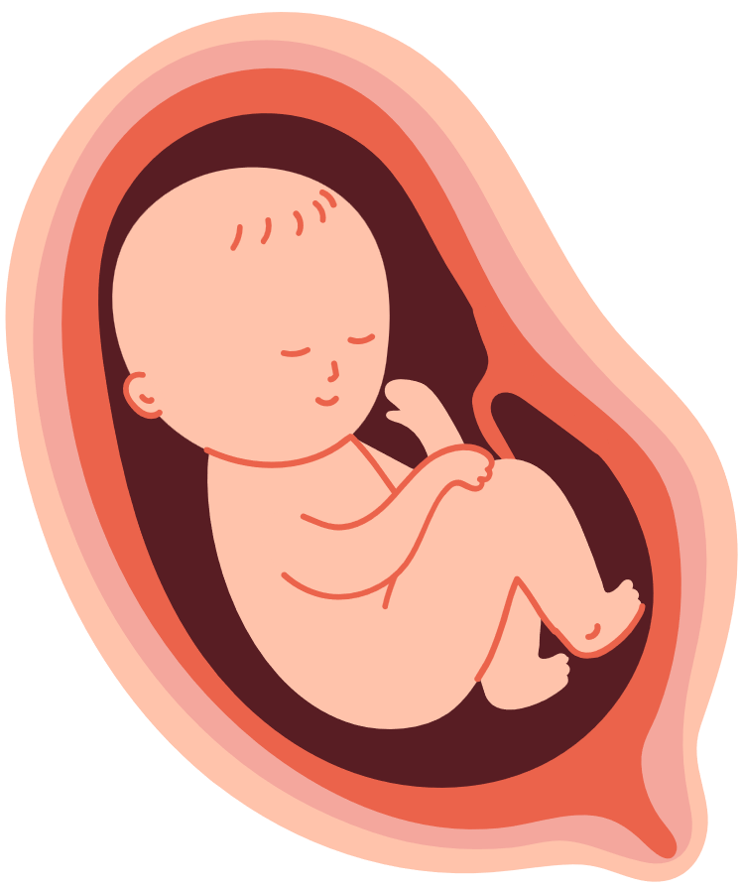
WONDERFULLY
MADE
A look into the stages of a baby’s life in the womb.
Notes:
Good morning!/afternoon! Today we’re going to take a look at the stages an unborn baby experiences as he or she grows in the womb. And we’re going to begin with how God’s Word describes the beginning of new life.
Read Psalm 139:13-16 -
13 For you formed my inward parts;
you knitted me together in my mother's womb.
¹⁴ I praise you, for I am fearfully and wonderfully made.
Wonderful are your works;
my soul knows it very well.
¹⁵ My frame was not hidden from you,
when I was being made in secret,
intricately woven in the depths of the earth.
¹⁶ Your eyes saw my unformed substance;
in your book were written, every one of them,
the days that were formed for me,
when as yet there was none of them.
God’s Word reminds us that every human being is woven together by God, every human is created by Him. That means every person is a wonderful work of His hands. Psalm 139 also indicates that every human being was planned. In fact, God knows the days of your life – when you would be born and when you will die – before you even came to be.
Today, we’re going to look at the stages of a baby’s life. Every human baby begins as a small being and then grows, changes, and develops. We are all wonderfully made by God. Today, we’re going to look at and admire His handiwork!

Slide 2


18 DAYS
Baby’s heart is beating
Notes:
What did God create that has a heartbeat? (people, animals) What does a heartbeat say about something? (It is alive.)
By the time a baby is 18 days old, his or her heart has started beating, and it will continue to beat for life. Baby is producing and pumping his or her own blood, and through baby’s placenta which attaches to mom inside her womb, baby will receive nutrients and use them to grow.

Slide 3
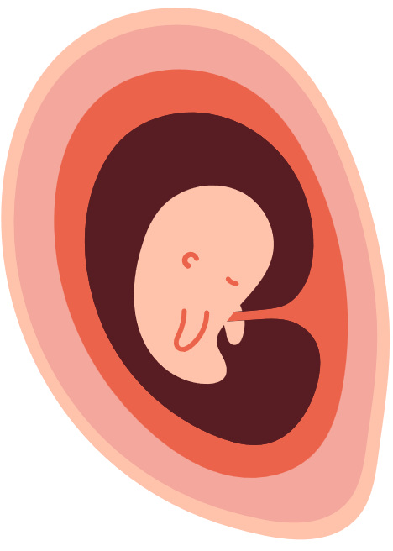
7 WEEKS
1/2" long
Eyes have some color.
Hands and feet are developing.
Brain is growing.
Appendix, pancreas, intestines are growing.
Blood vessels carry oxygen and nutrients.
Baby can hiccup.
Baby starts to move and exercise muscles.
Notes:
Notice how many essential organs and parts of the body are present and growing already at this stage. All of the organs inside a human body begin to develop simultaneously, or at the same time, because they are all needed for life. Our bodily systems are designed to work together.

Slide 4
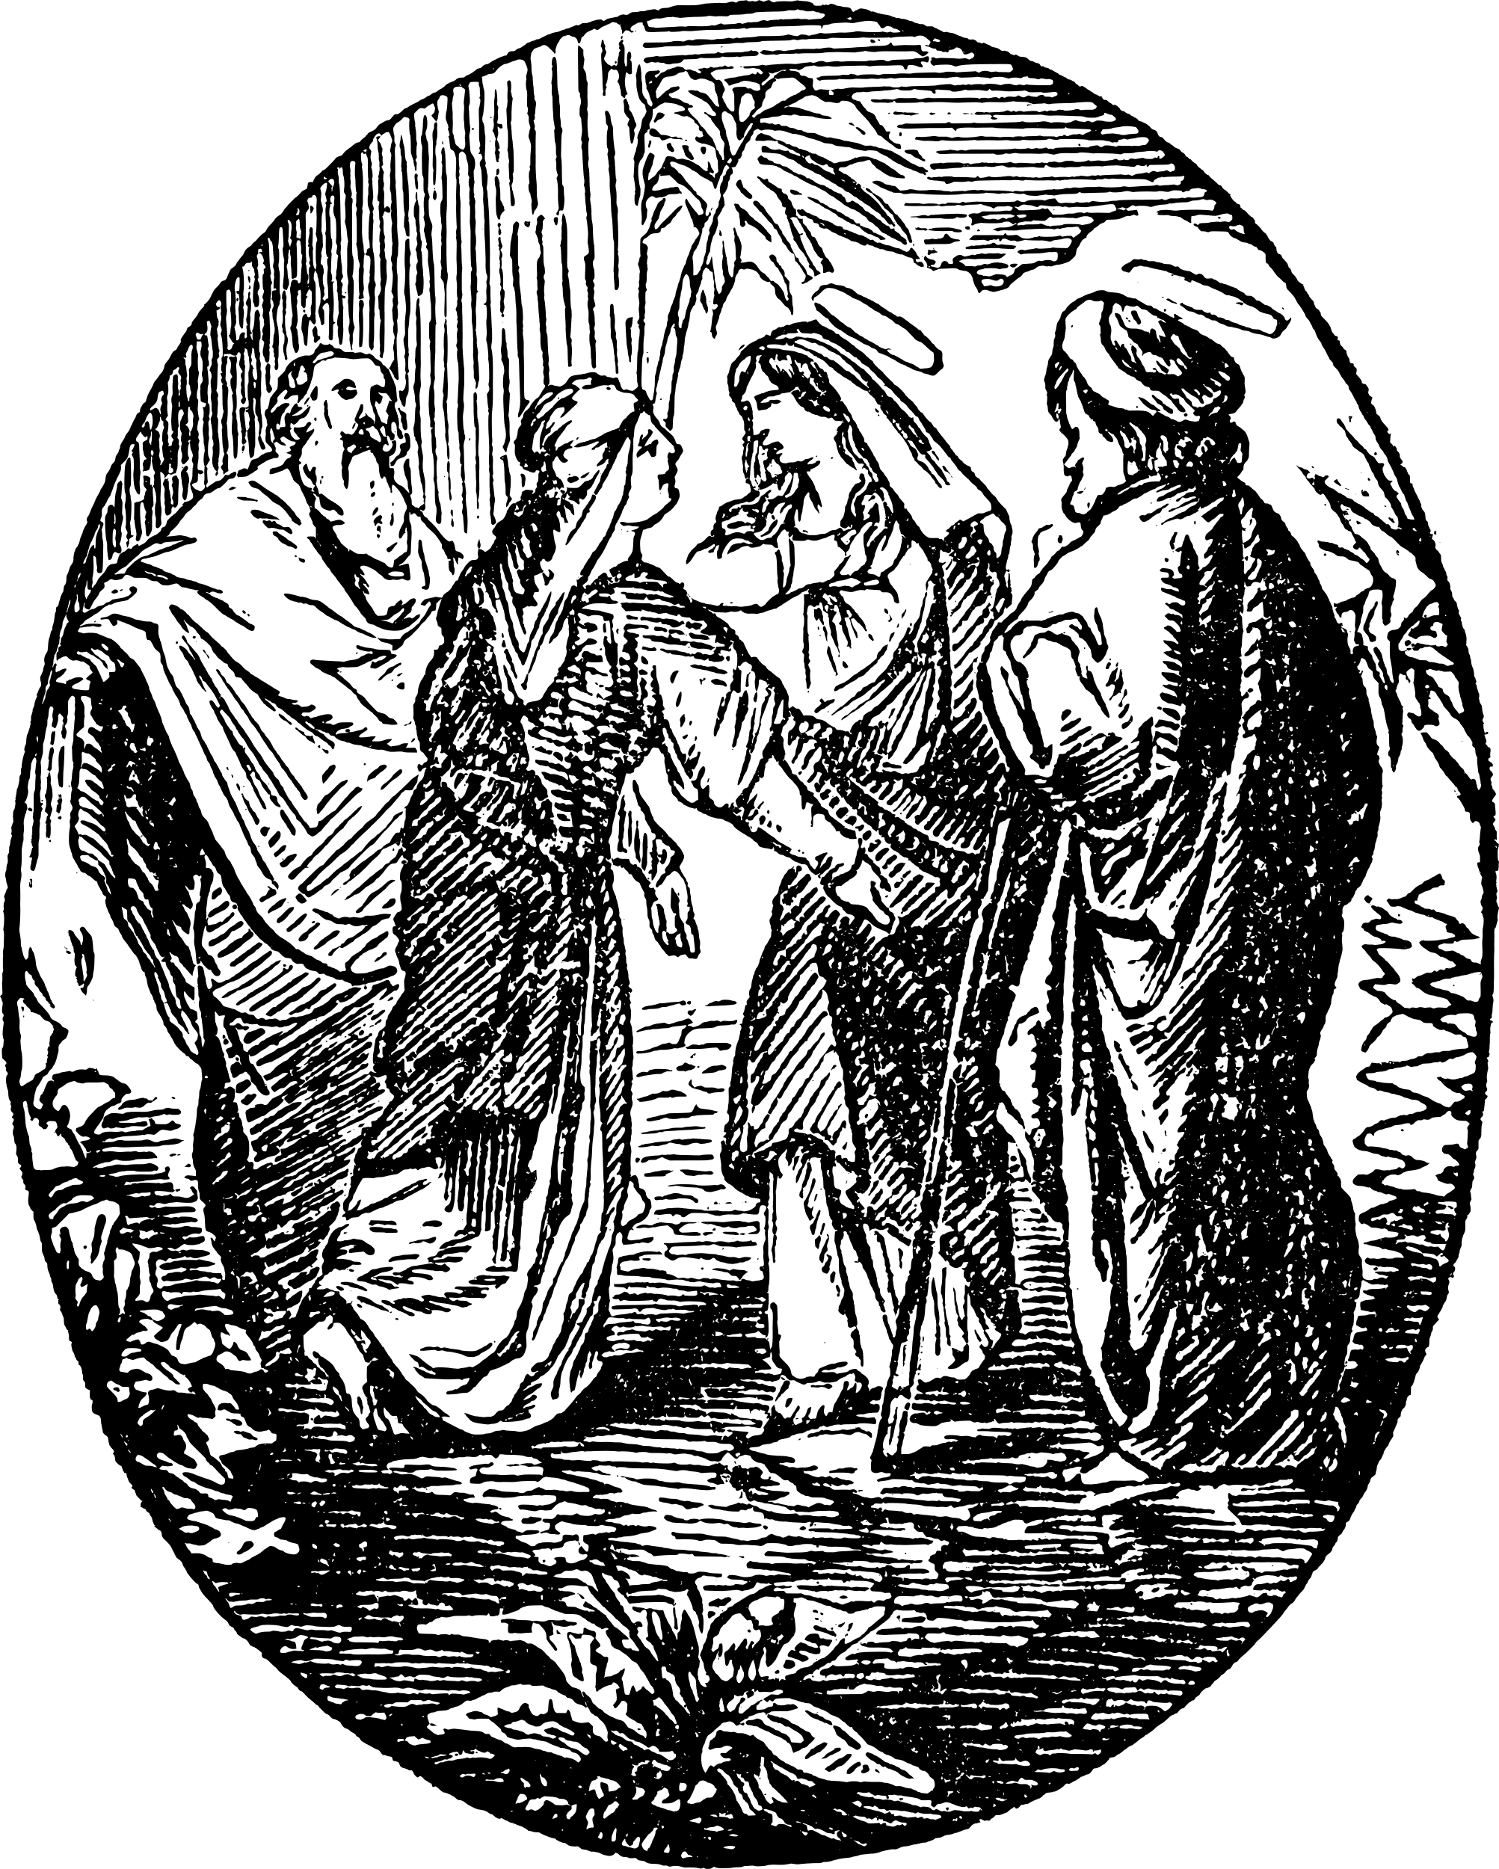
Baby John & Baby Jesus
Elizabeth’s unborn baby, John, was aware of baby Jesus when Mary was carrying Him.
Luke 1:44- “As soon as the sound of your greeting reached my ears, the baby in my womb leaped for joy.”
Baby John already knew Jesus as his Savior at this age. God can grant faith even before a baby is born.
Notes:
What does John leaping in his mother's womb tell us?
1) John is alive. (And so is Jesus!)
2) He knows Jesus already.
3) He has faith.

Slide 5
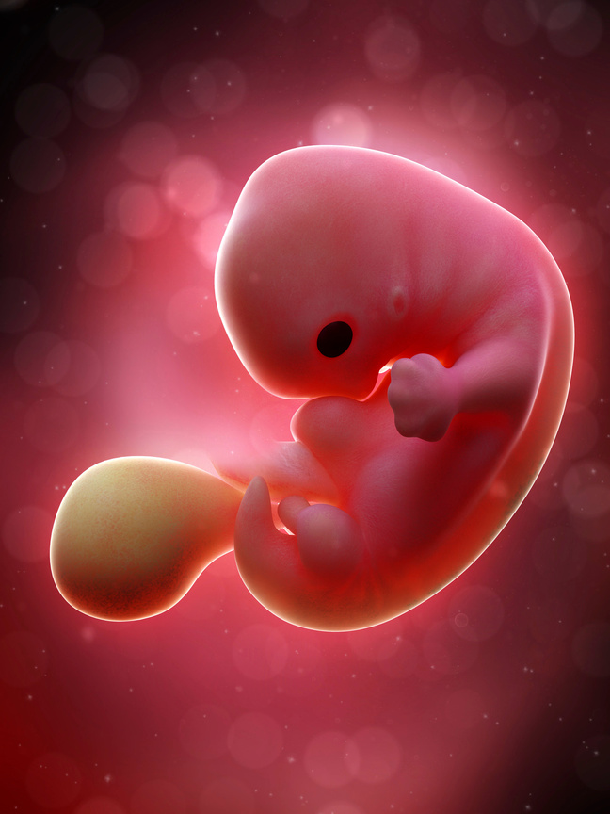
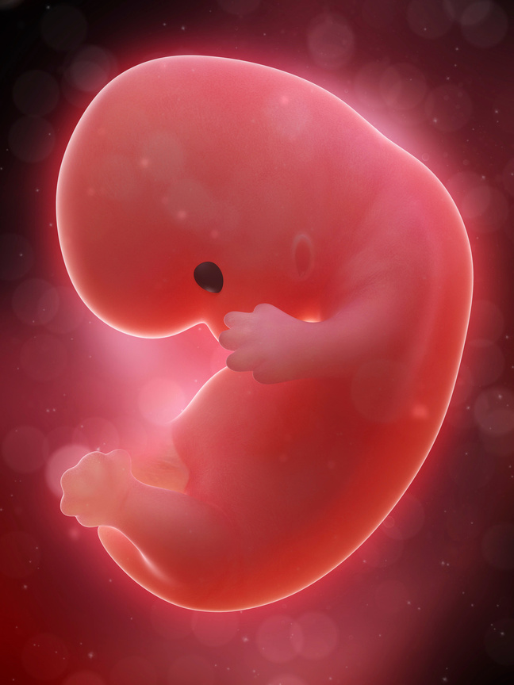
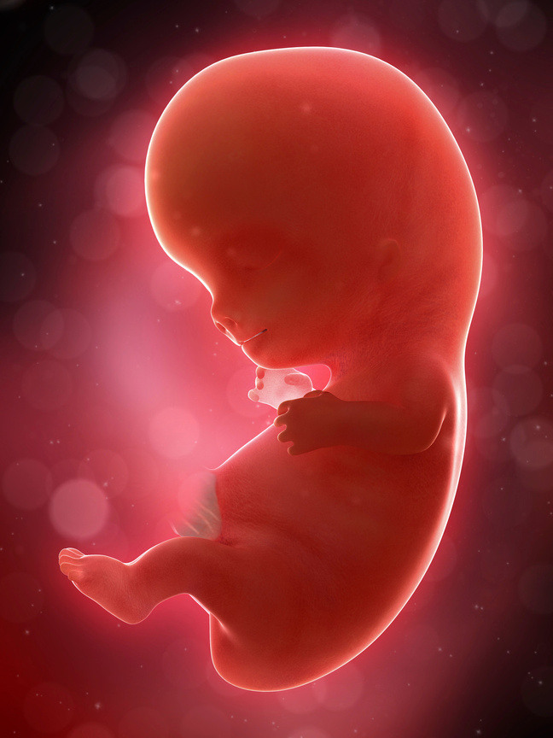
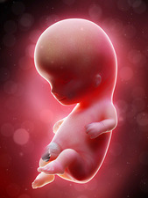
7, 8, 9, and 10 weeks
Notes:
In just four weeks, how much does a baby grow? He or she almost triples in size!

Slide 6
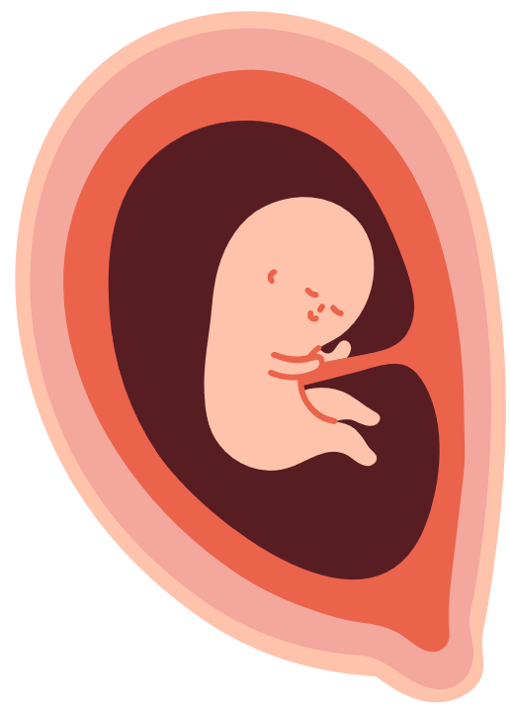
12 WEEKS
Size of a lime
Fingers can open and close.
Toes can curl.
Baby can swallow.
Baby feels and responds to touch and pain.
Baby can smile.
Baby can suck his or her thumb.
Notes:
[Pass around the 12-week fetal model.]
[Show lime.]
Several things show the baby's humanity at this stage: opens hands, curls toes, smiles, and feels touch.

Slide 7

Psalm 139:13- “For you created my inmost being; you knit me together in my mother’s womb.”
All the parts of a baby are made with purpose by God. None of it is an accident.
Notes:
Remember Psalm 139? Because God creates every baby, every baby is planned by God. God’s design for human life is the perfect design. Each stage not only enables a baby to grow but also upholds and prepares the baby for his or her next stage in life. No baby is created by chance or accident.

Slide 8
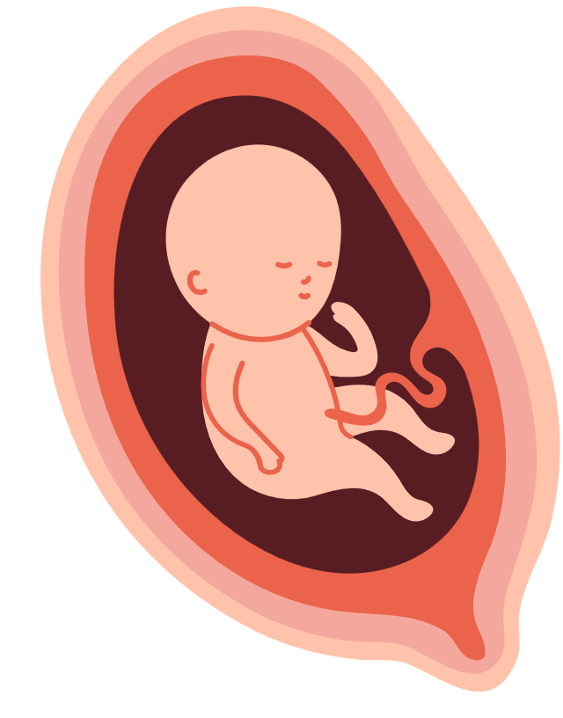
22 WEEKS
Size of a banana
Practices swallowing
Can make facial expressions
Over half-way through pregnancy
Taste buds are working.
Eyebrows and eyelashes are growing.
Can open and close eyes
Notes:
At 16 weeks a mother can feel the baby moving. (Pass around the 16-week baby.) You’ve quadrupled in size in just a month. At this stage, a baby begins exploring his or her space in the womb. His or her hair pattern will be established. Now at 22 weeks [pass 22-week model around], what are some ways you see the baby preparing for life outside the womb?

Slide 9
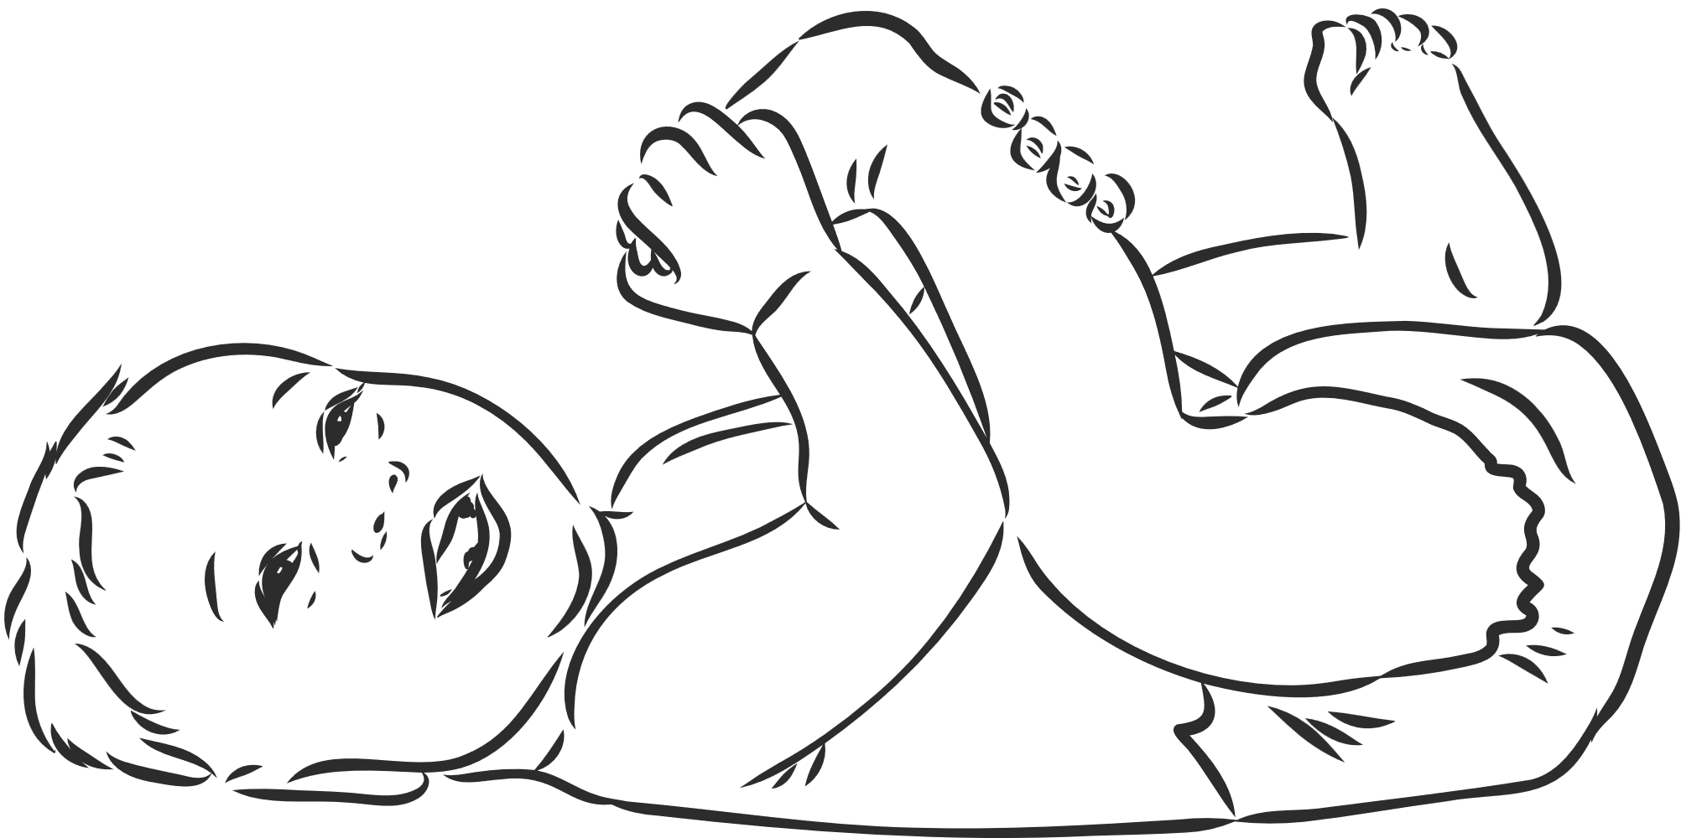
Psalm 139:14- “I praise you because I am fearfully and wonderfully made; your works are wonderful, I know that full well.”
We praise and thank God for making all of us with such care. Since God put so much care, time, and work into creating each baby, we want to take care of each baby, protect him or her, and thank God for the gift of children.
Notes:
A baby is a human being, handmade by God and redeemed by Jesus. Jesus died for each baby so that each person might be forgiven and live forever with Him. The Holy Spirit desires to bring each human being to faith in Jesus, to establish an eternal relationship with them. These three realities – that every human being is created and redeemed and that the Holy Spirit desires the call them to faith – makes each human life, born or unborn, valuable.
Sometimes the world does not agree that all lives are valuable. Sometimes babies are described as blobs of tissues to dehumanize them. Others might argue that a baby should only be able to live if he or she is wanted by the mother. Scientifically, are these good arguments? (No, science proves that babies are more than blobs of tissue; they are genetically distinct and whole human beings. Though the baby temporarily depends on his or her mother for food, shelter, and clothing, a baby’s life is separate from the life of the mother.) What does God’s Word say about arguments that dehumanize a baby? (God’s Word values and protects the lives of the unborn. In fact, the Bible repeatedly describes children as gifts. God’s Word is clear that murder is wrong and that the Christian is called to uphold the lives of those who cannot speak for or defend themselves. A baby is a new life, handmade by God. Only God can determine when life begins and when it ends.)

Slide 10
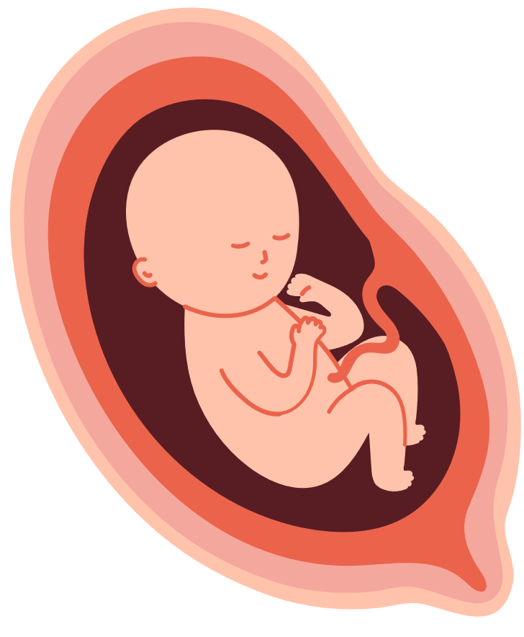
26 WEEKS
Size of a head of cauliflower
Sweat glands are working.
Baby can hear you.
Lungs are developing.
Immune system is developing.
Notes:
[Pass around 26-week model.]
What would be some good things for the baby to hear?

Slide 11

Psalm 139:14- “My frame was not hidden from you when I was made in the secret place. When I was woven together in the depths of the earth, your eyes saw my unformed body. All the days ordained for me were written in your book before one of them came to be.”
God has each person’s life planned - “written in His Book” - before that life ever began. That is how well He cares for and knows each person.
Notes:
When a baby is this old, no one really knows what he or she will look like. What color the baby's eyes will be, what kind of nose he or she has, what his or her smile looks like. But God knows! It is a secret to us, but God knows exactly who this baby is and what he or she looks like. He knows exactly what he or she will be good at and what he or she will do in his or her life.

Slide 12
30 WEEKS
Size of a large cabbage
Baby is very active.
Others can see movement.
Bones are fully developed.
Baby is gaining fat.
Eyes are open.
Notes:
At this point, a baby could survive outside the womb. (In fact, some babies have survived as early as 21 weeks!) Babies that arrive this early will need to spend time in the hospital, but they won’t be there forever.
A full-term baby is one who spends between 38 and 40 weeks in his or her mother’s womb.
Why, if the baby could survive outside the womb, is it is important for the baby to go to full term? (The longer the baby stays in the womb, the better prepared the baby will be for life outside the womb. He or she will have gained more weight and had an opportunity for his or her lungs to fully develop.)

Slide 13
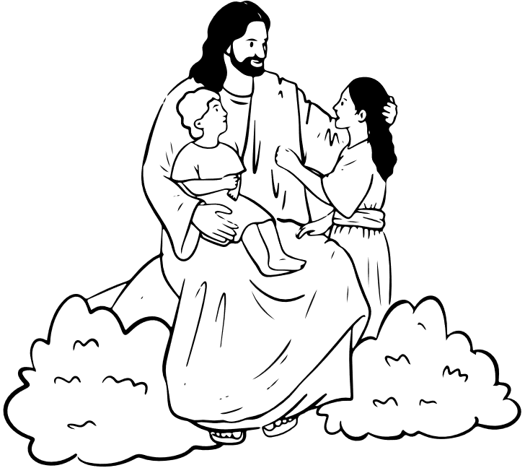
Psalm 49:1- “Listen to me, you islands; hear this, you distant nations: Before I was born the Lord called me; from my birth he has made mention of my name.”
God calls us as His children and knows our name even before we are born!
Notes:
What does having a name show? It shows that someone has value or is important. God knows our names from day one. That is just one example of how very important we are to God. It also shows how very important every unborn baby is. Each person, born or unborn, is valuable because he or she has been created, redeemed, and called.

Slide 14


Created by Lutherans For Life and Y4Life
Images sourced from Canva and Science Photo Library

